Slide 1
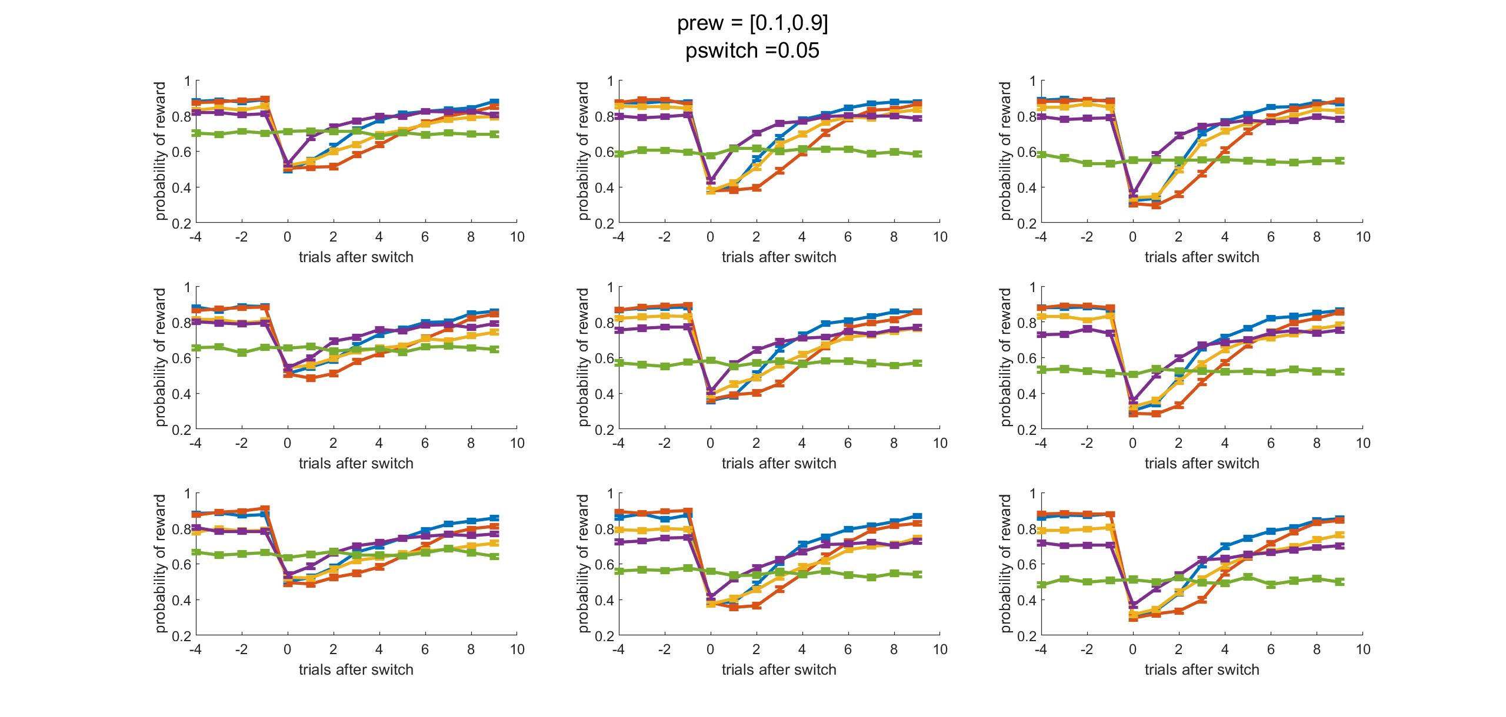
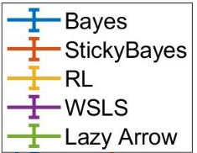
Ndirections
2 3 4
Nbandits
5 4 3

Slide 2
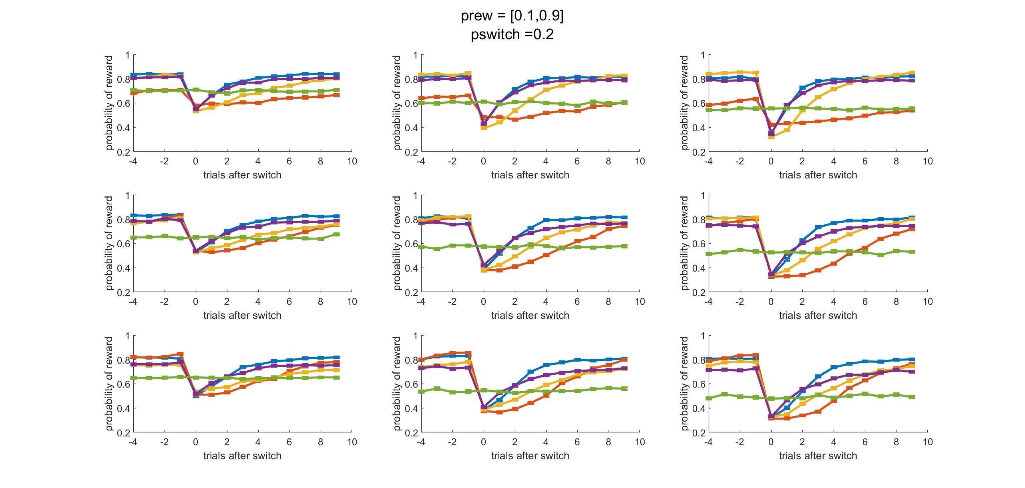
Ndirections
2 3 4
Nbandits
5 4 3

Slide 3
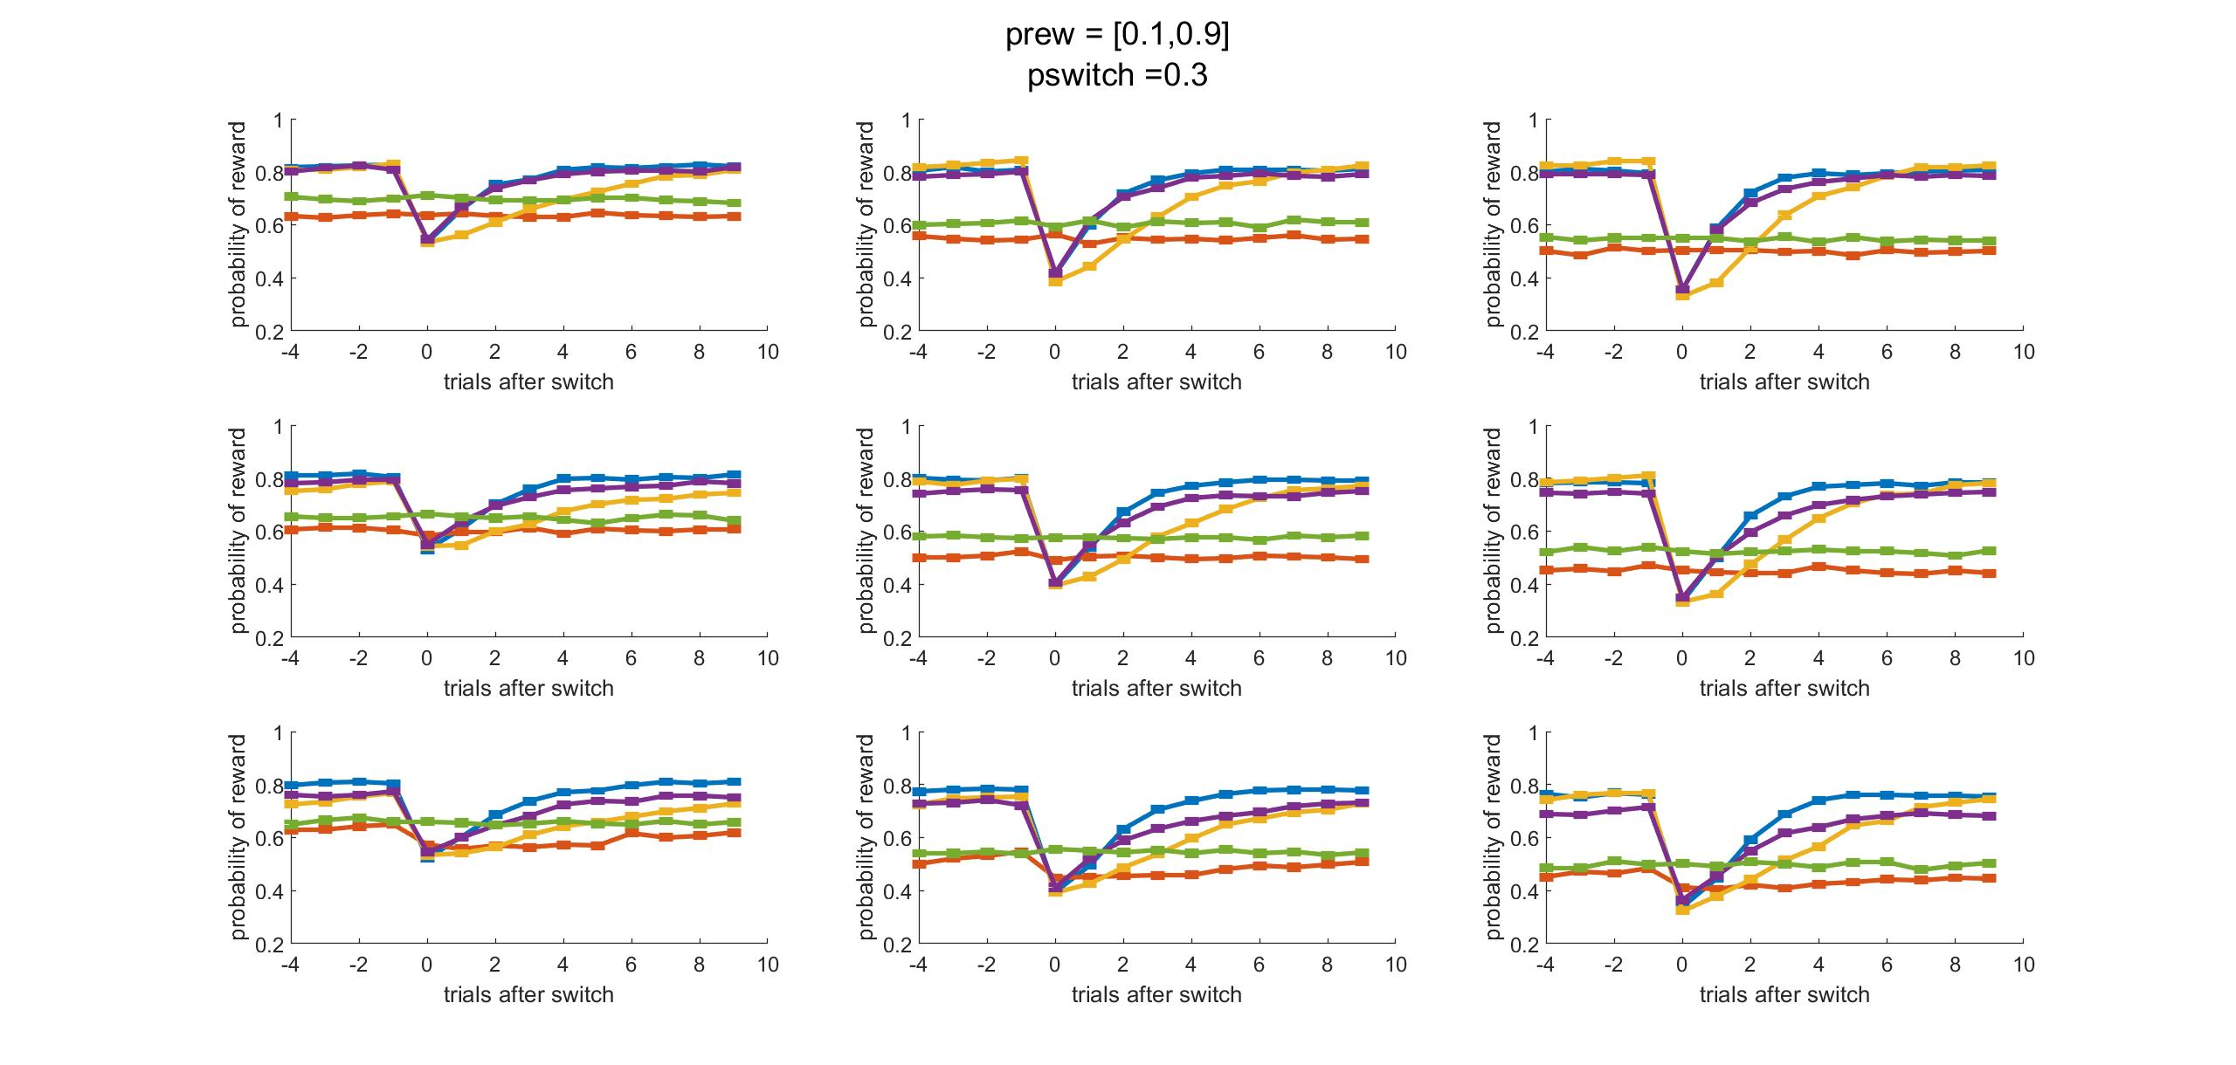
Ndirections
2 3 4
Nbandits
5 4 3

Slide 4
Week 1/17

Slide 5
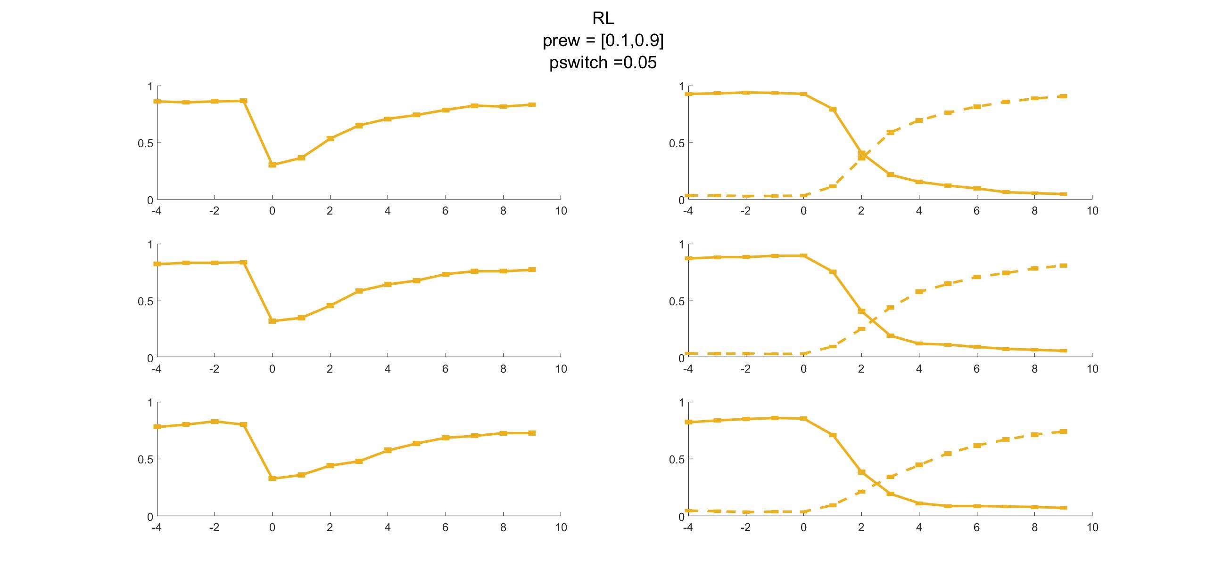
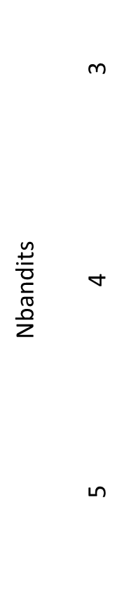
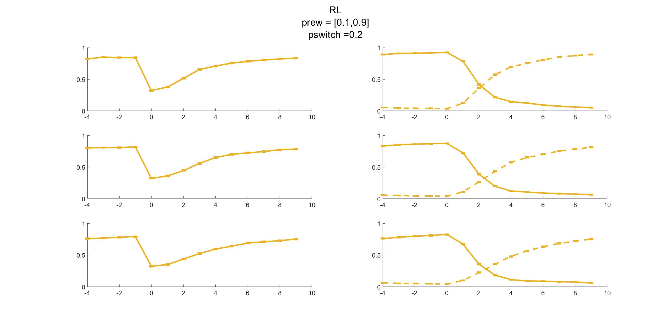

Slide 6
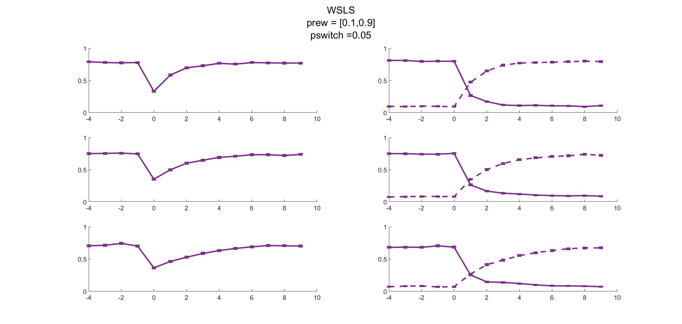
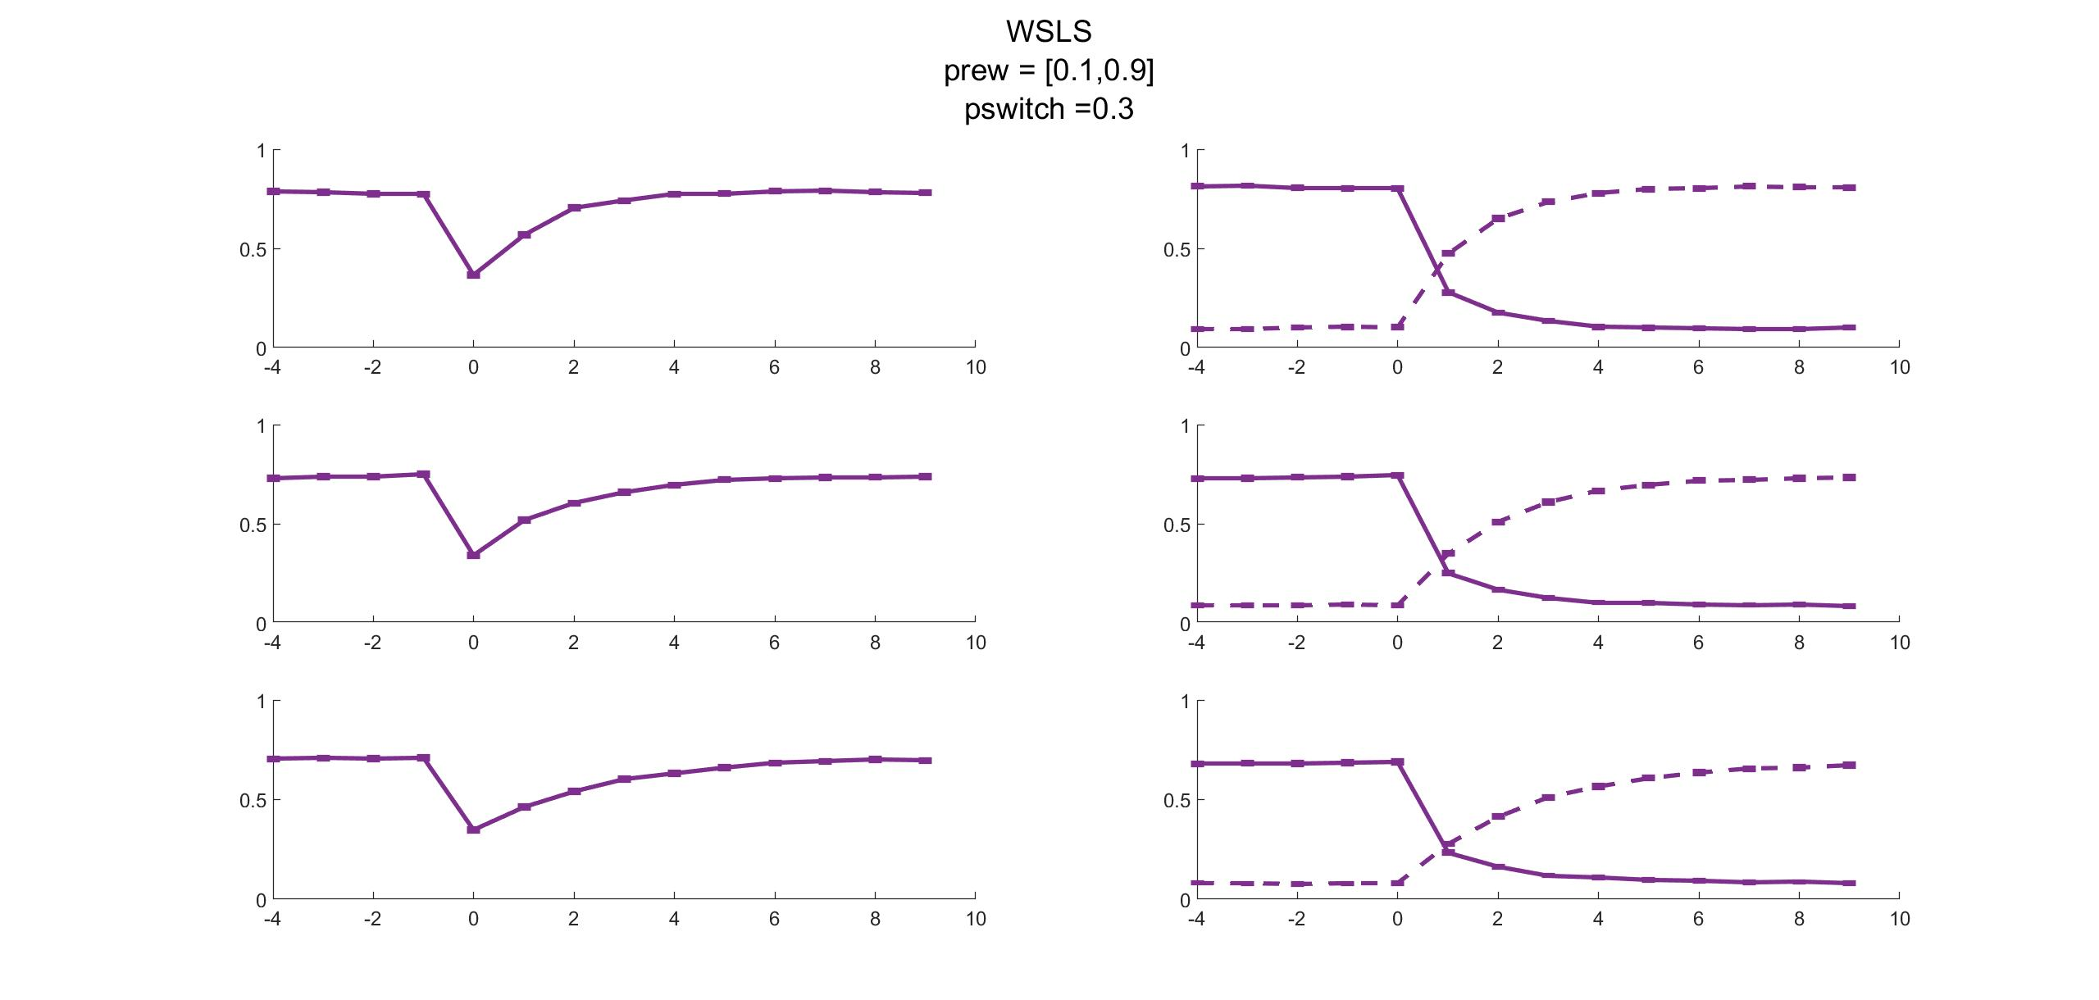

Slide 7
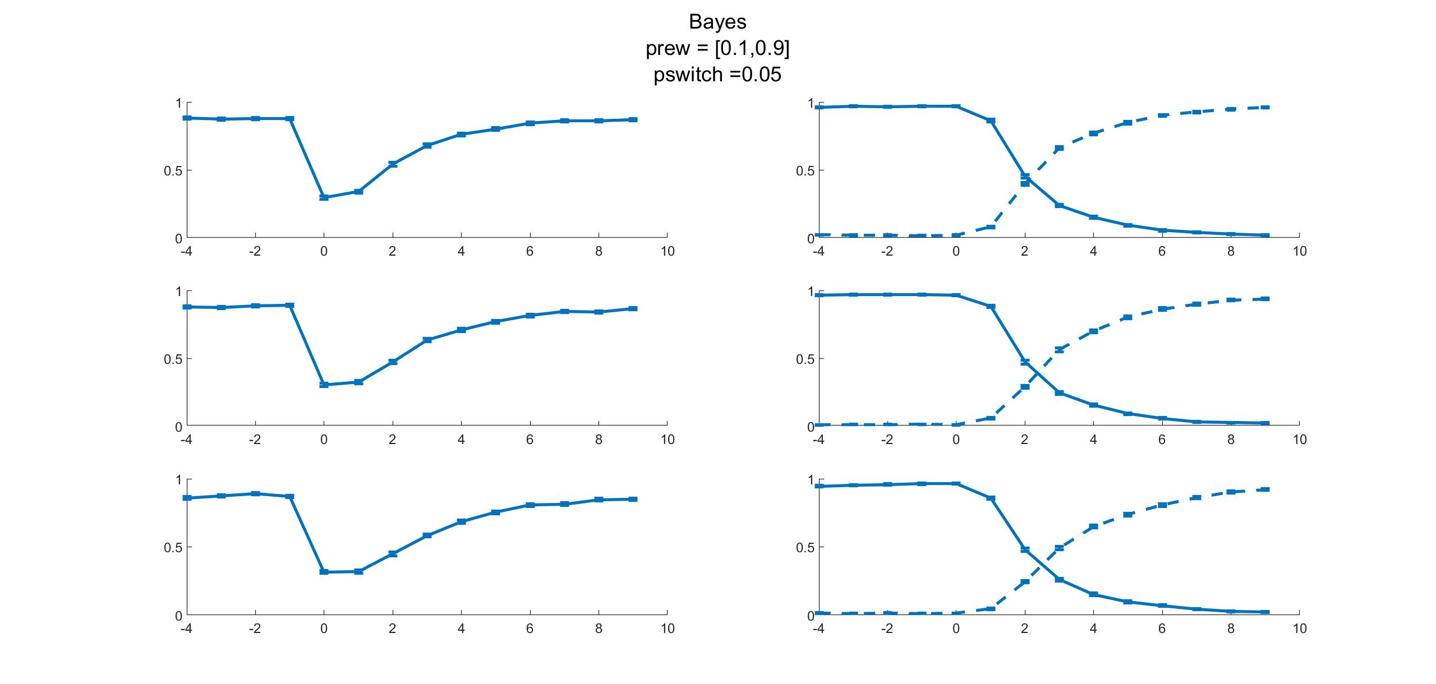
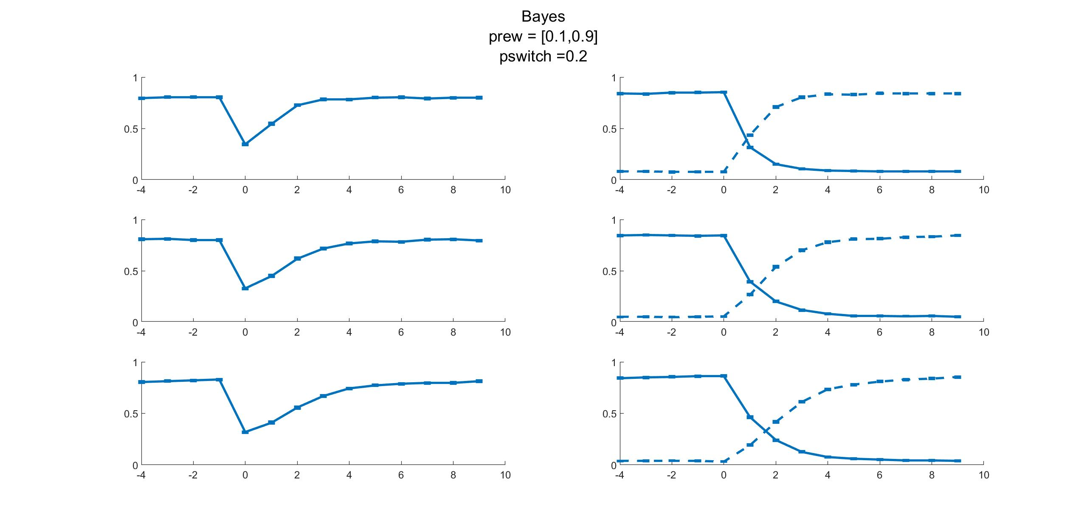

Slide 8
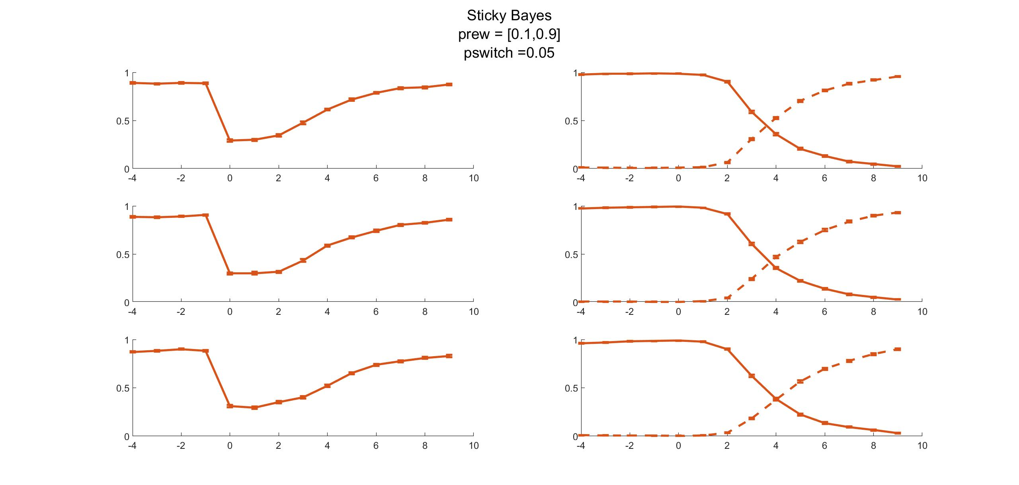
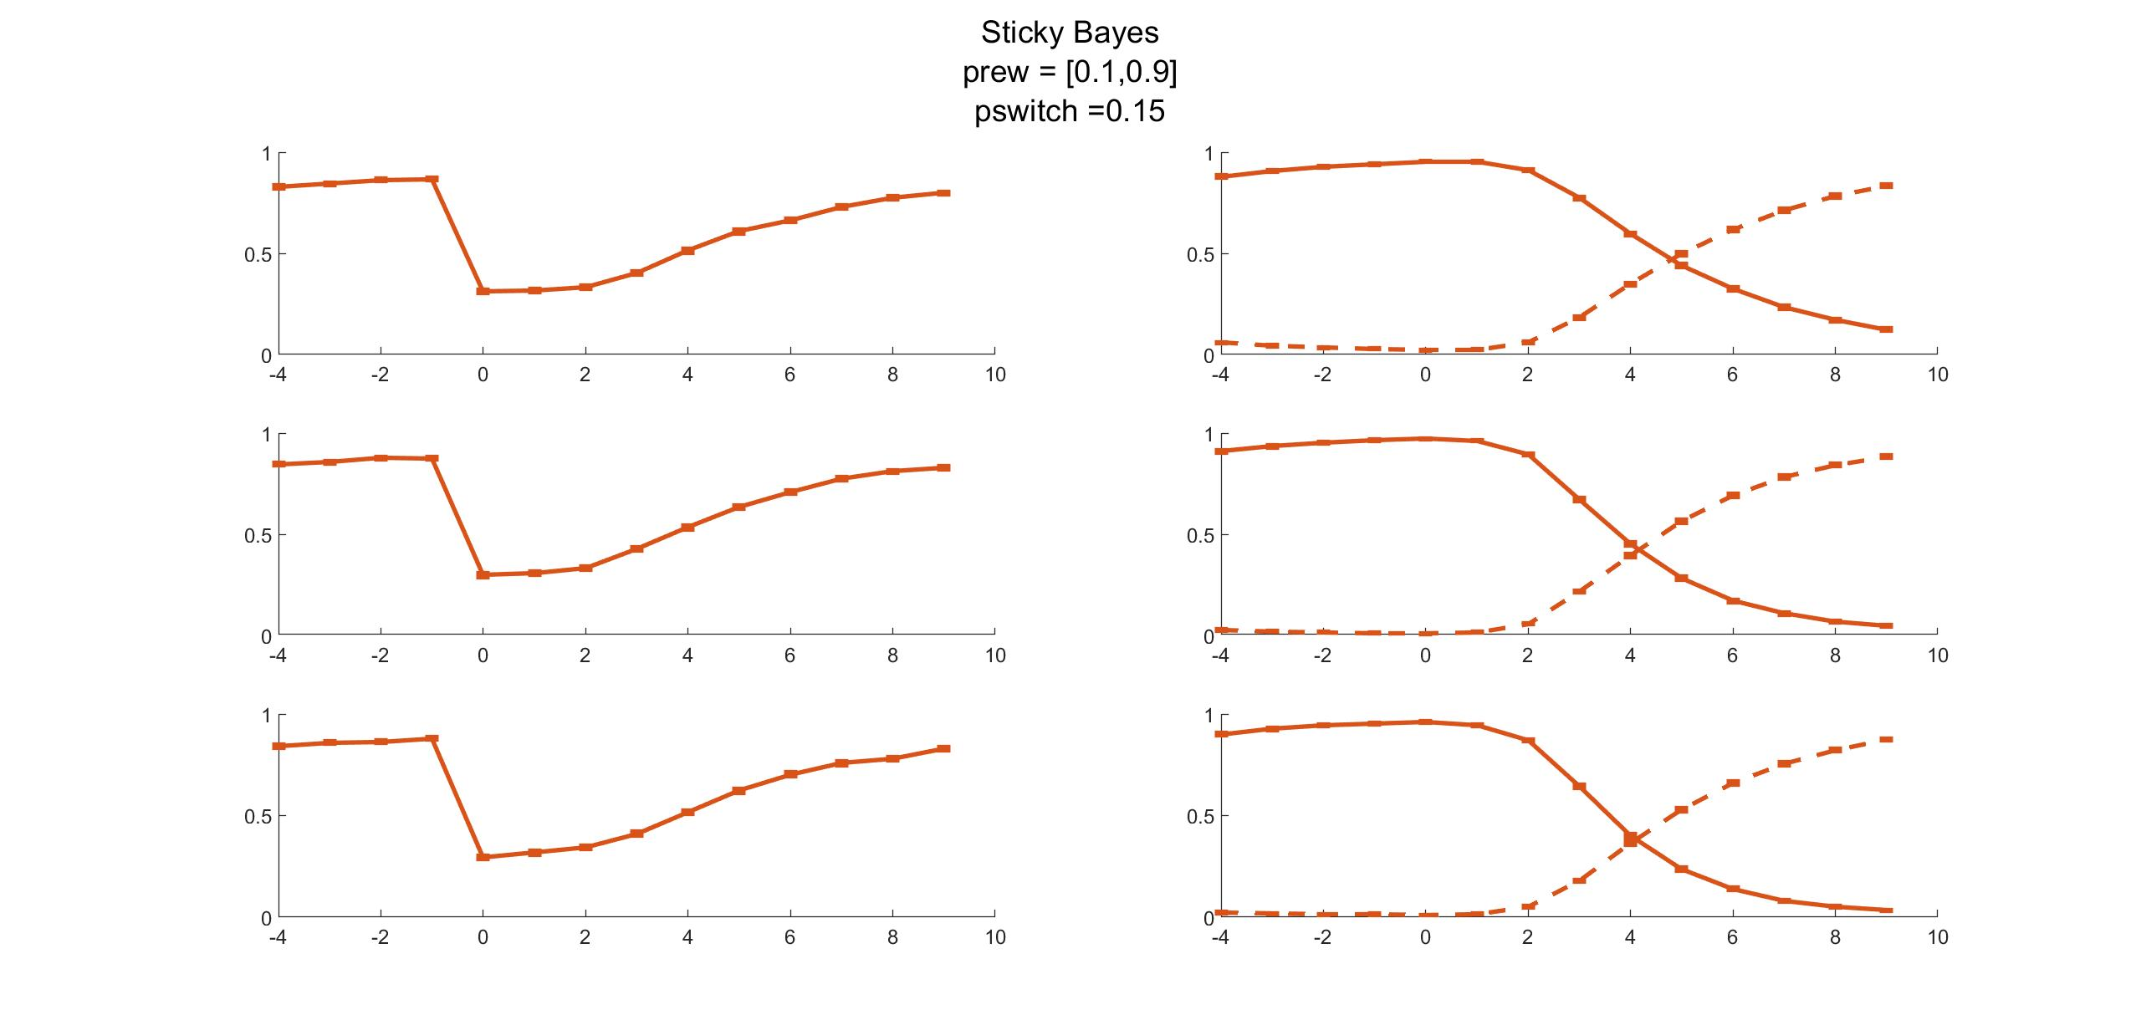
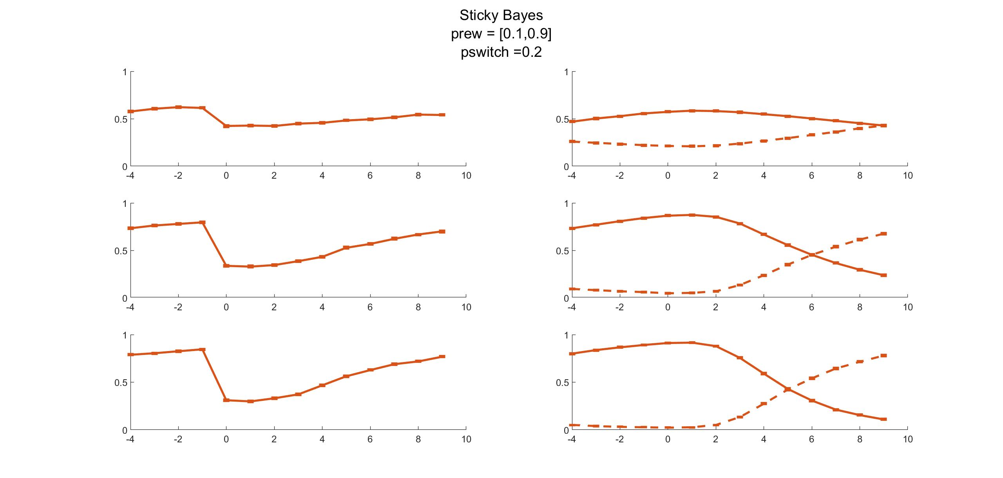

Slide 9
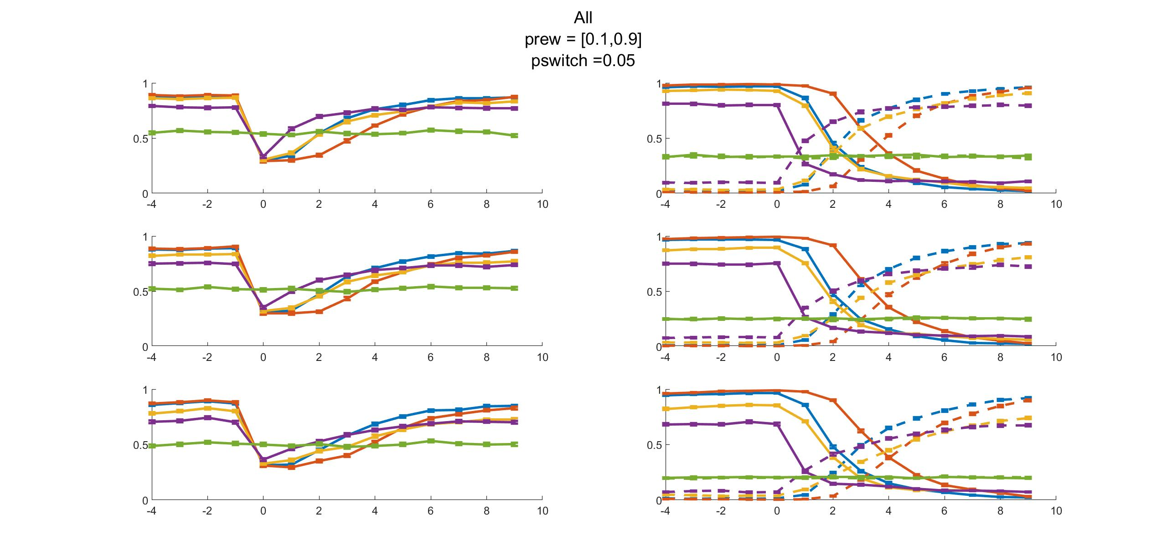
Reward Bandit (old vs new)
Nbandits
5 4 3

Slide 10
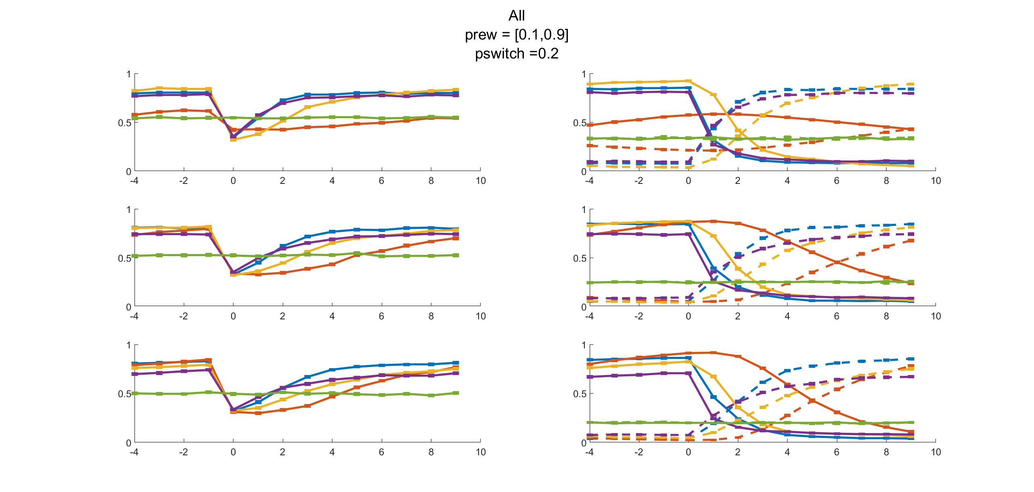
Reward Bandit (old vs new)
Nbandits
5 4 3

Slide 11
New Stimuli Generation

Slide 12
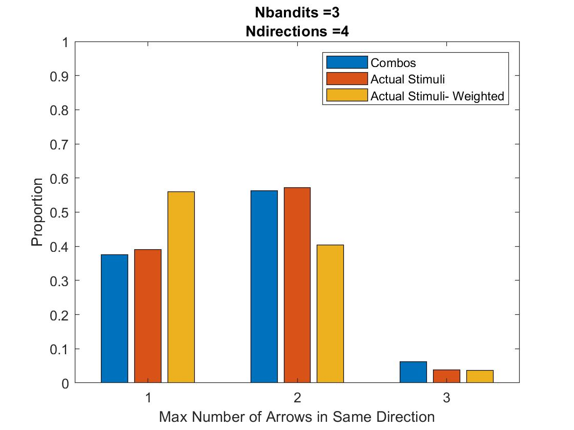
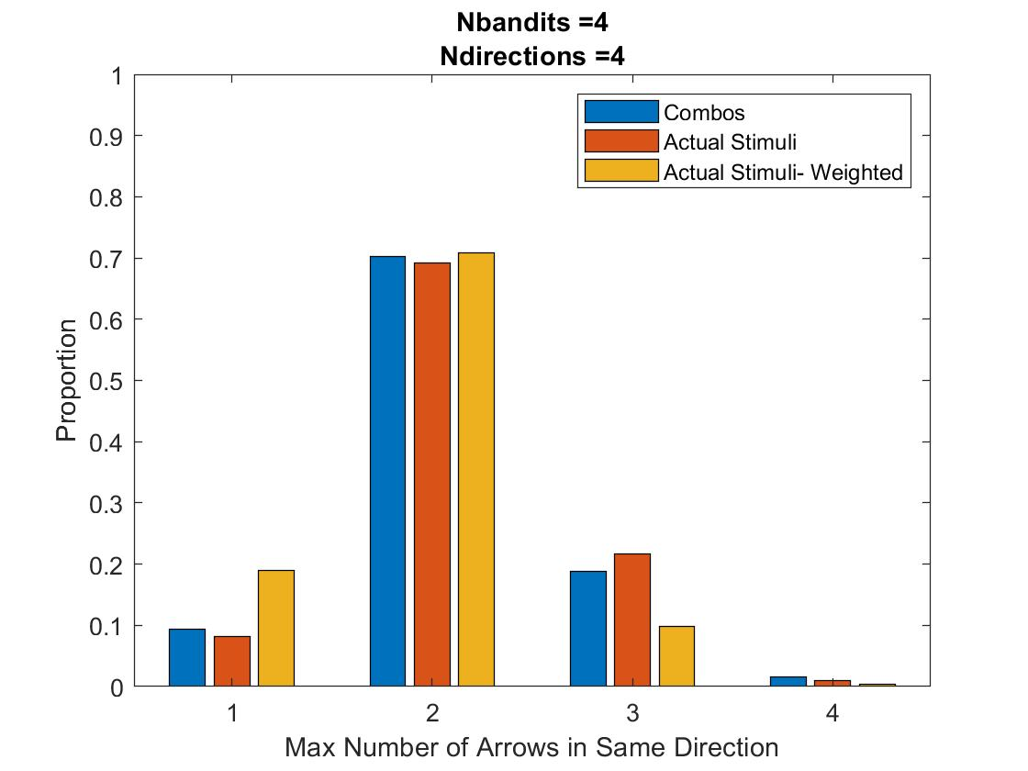
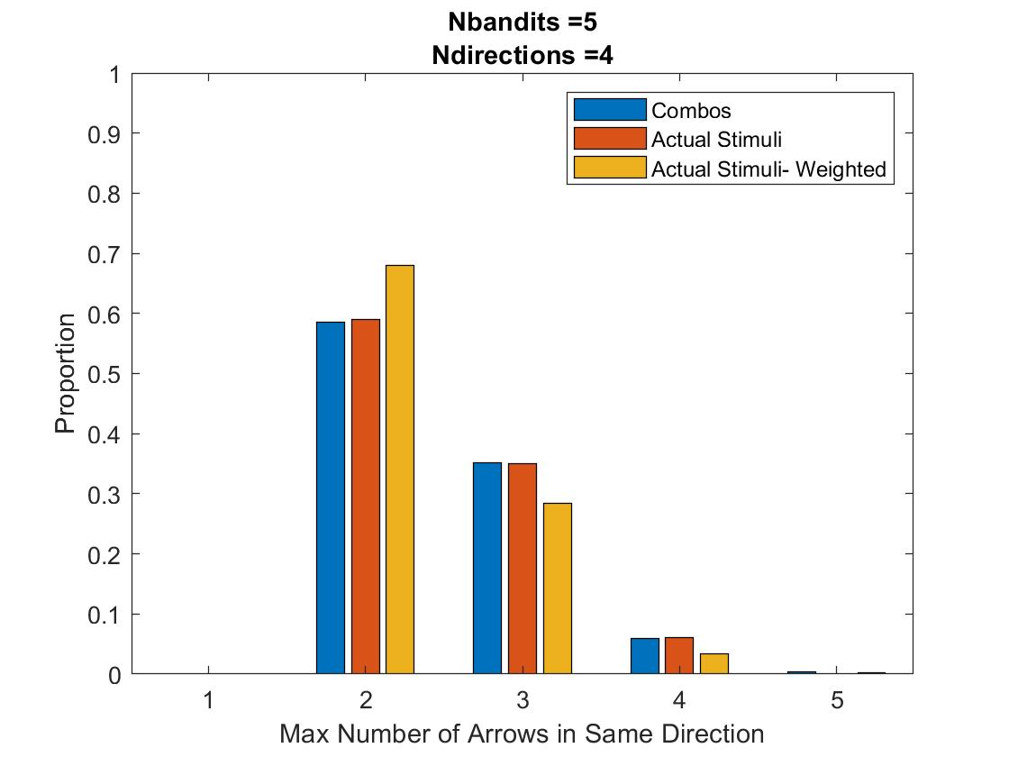
Stimuli Occurrences
Max all-same: 5% of trials
Unweighted: Psame = Pdiff = 1/Ncombos
Weighted: Psame = 1/Nbandits, Pdiff dependent on num same
Ref = 10

Slide 13
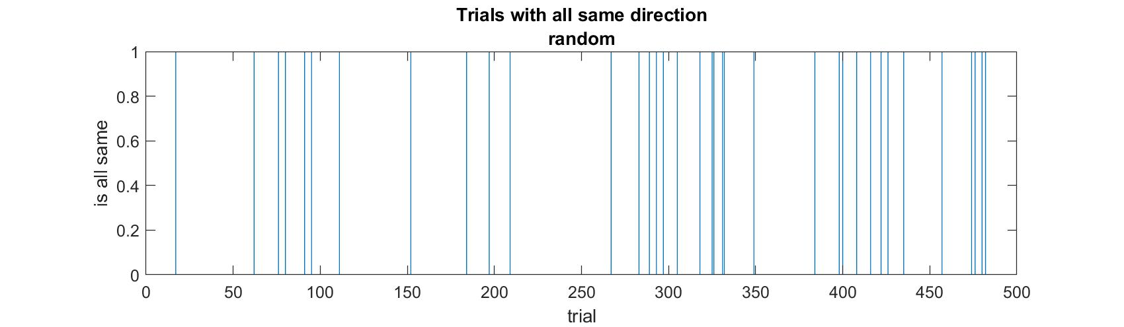
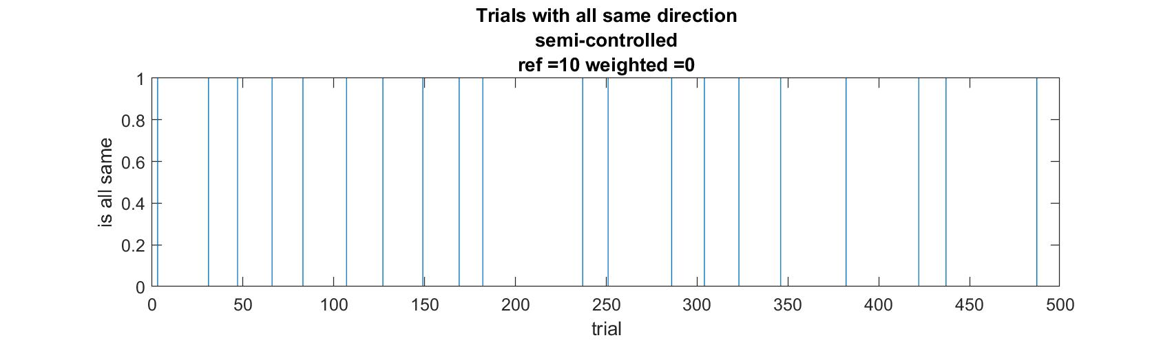
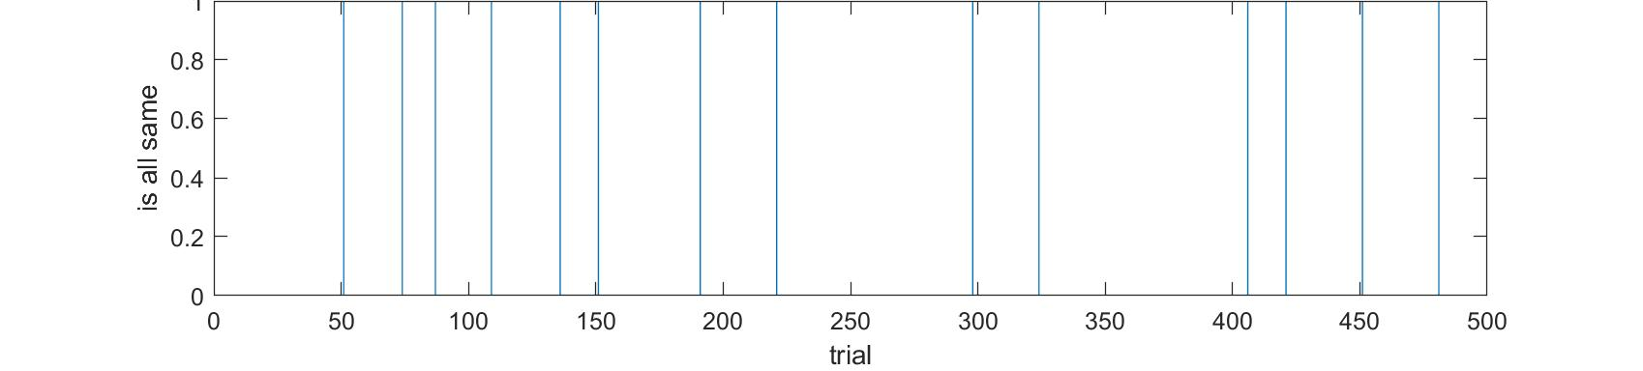
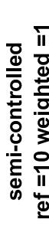
Notes:
Ndirections =4
Nbandits =3

Slide 14
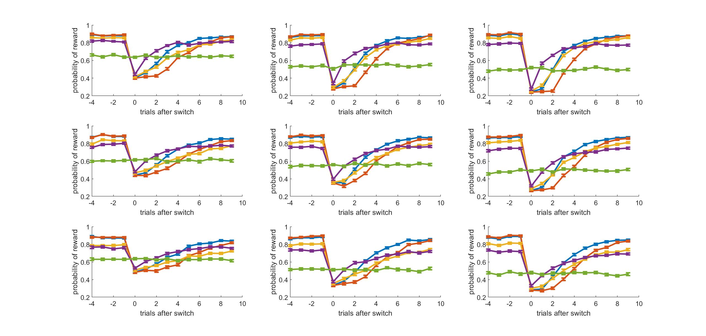
Ndirections
2 3 4
Nbandits
5 4 3
Notes:
NEW

Slide 15
Ndirections
2 3 4
Nbandits
5 4 3
Notes:
OLD

Slide 16
Curve Fitting

Slide 17
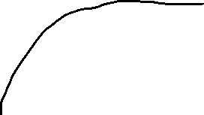
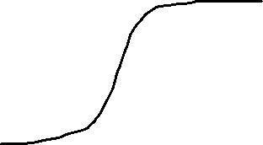
Fitting to curves to exponential
y = a + b*exp(c*x)
a to get asymptotic value?
Fit options for increasing vs decreasing functions (p_new vs p_old & rew)
Fit is best for something like WSLS which has immediate change, but worse for models that have some kind of delay/slower to change
Although r² is still good, tends not to capture shape
Good for:
Not good for:

Slide 18
Fitting to curves to logistic
y = a/(1 + exp(-k*(x-b)))
a -> asymptotic value
k -> steepness
b -> midpoint
Good for:

Slide 19
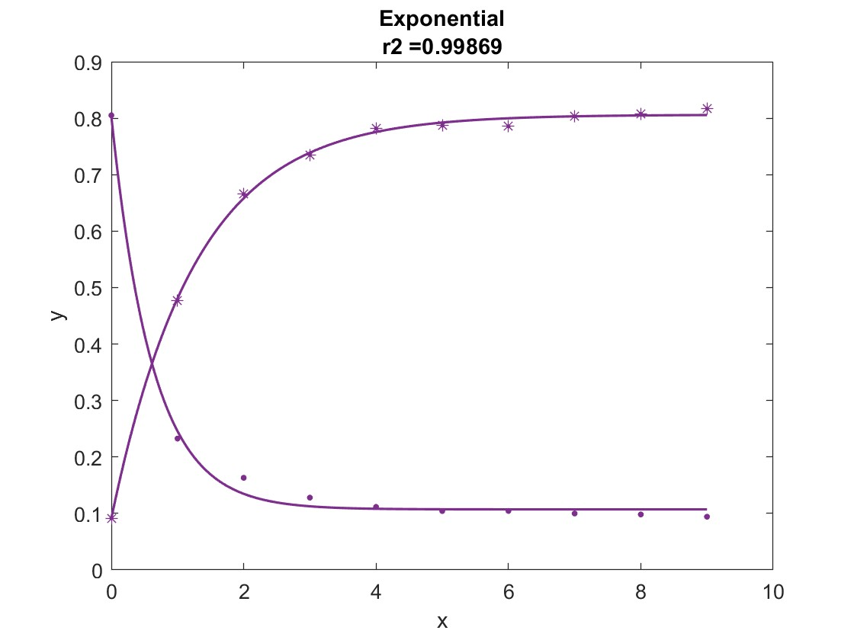
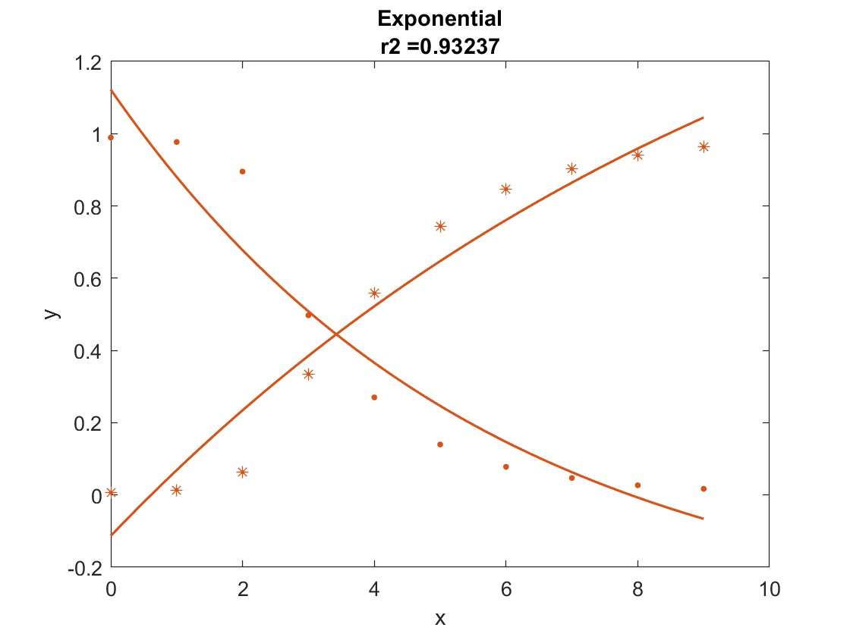
Exponential Examples
Old Bandit (.)
New Bandit (*)
WSLS
Sticky Bayes
Notes:
Both have good r2 values but fit doesn’t capture shape well

Slide 20
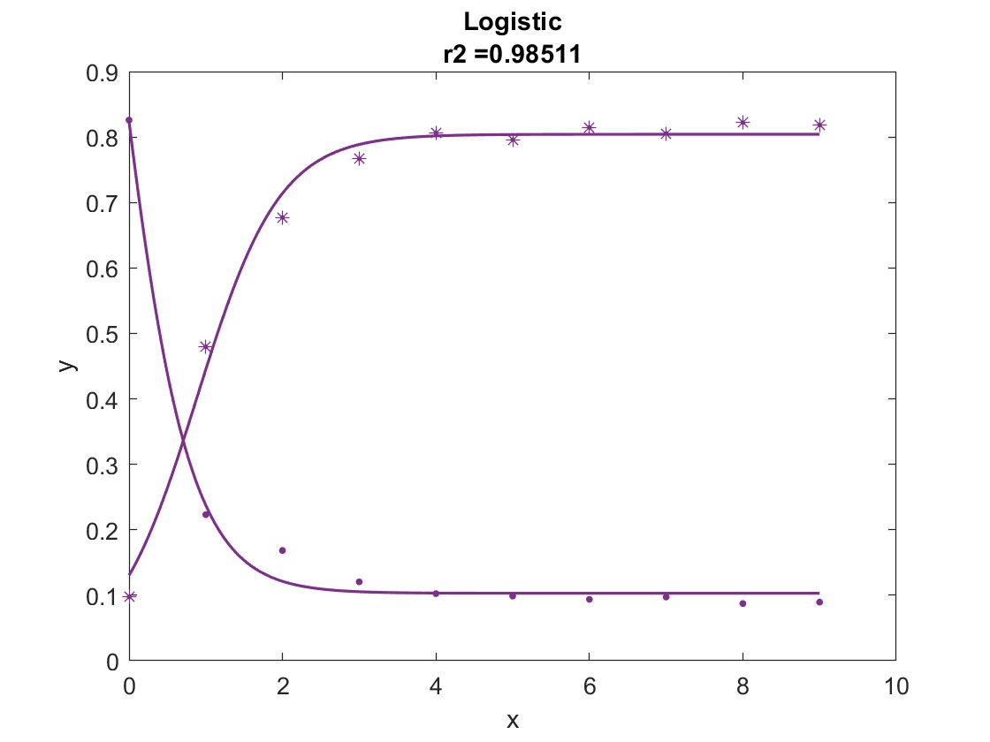
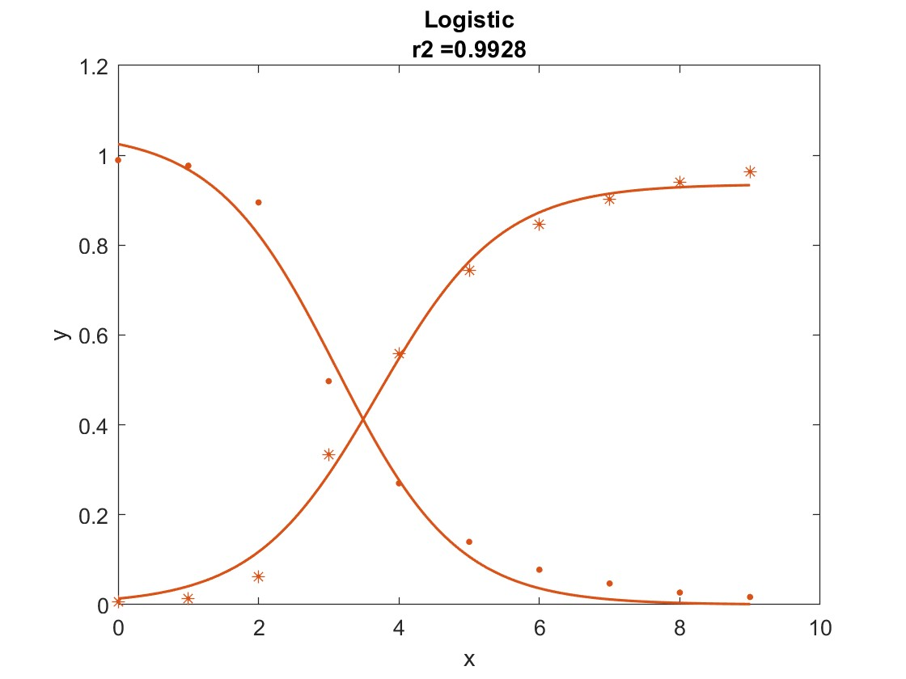
Logistic Examples
Old Bandit (.)
New Bandit (*)
WSLS
Sticky Bayes
Notes:
Both have good r2 values but fit doesn’t capture shape well

Slide 21
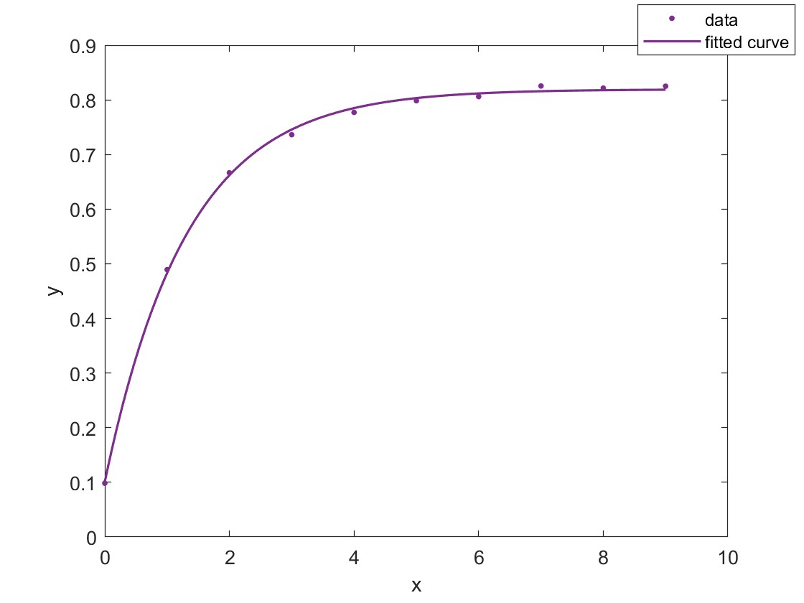
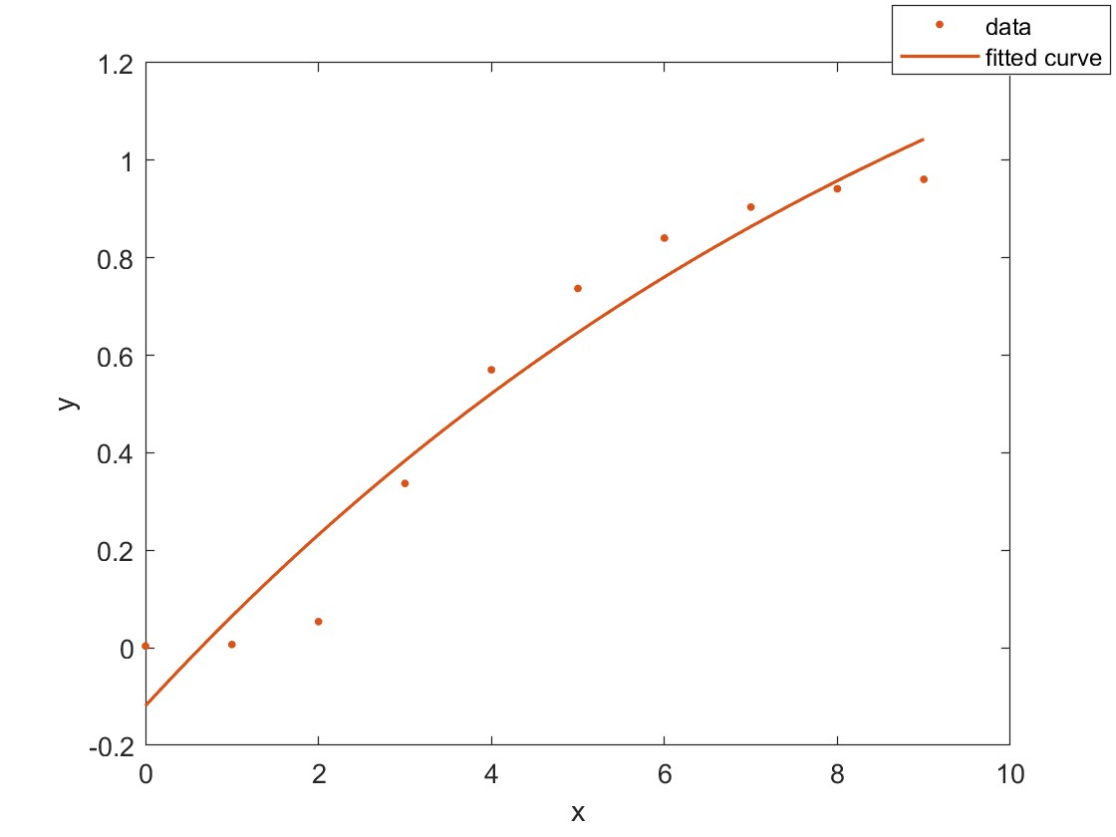
Examples
New Bandit
WSLS
Sticky Bayes
Notes:
Both have good r2 values but fit doesn’t capture shape well

Slide 22
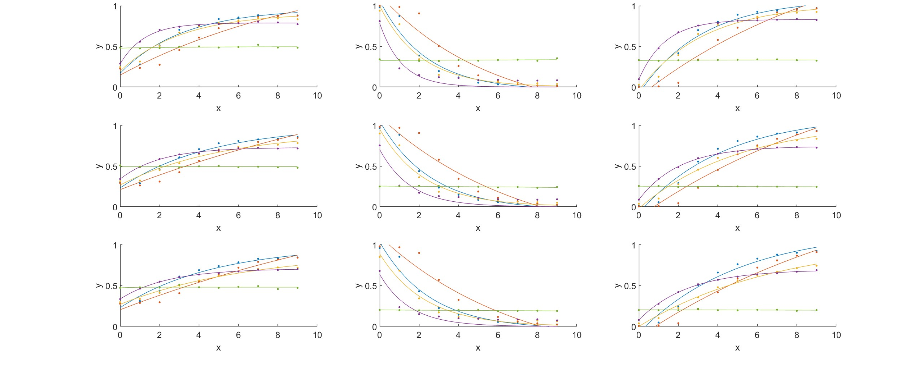
Fitting to curves to exponential- examples
Reward
Old Bandit
New Bandit

Slide 23
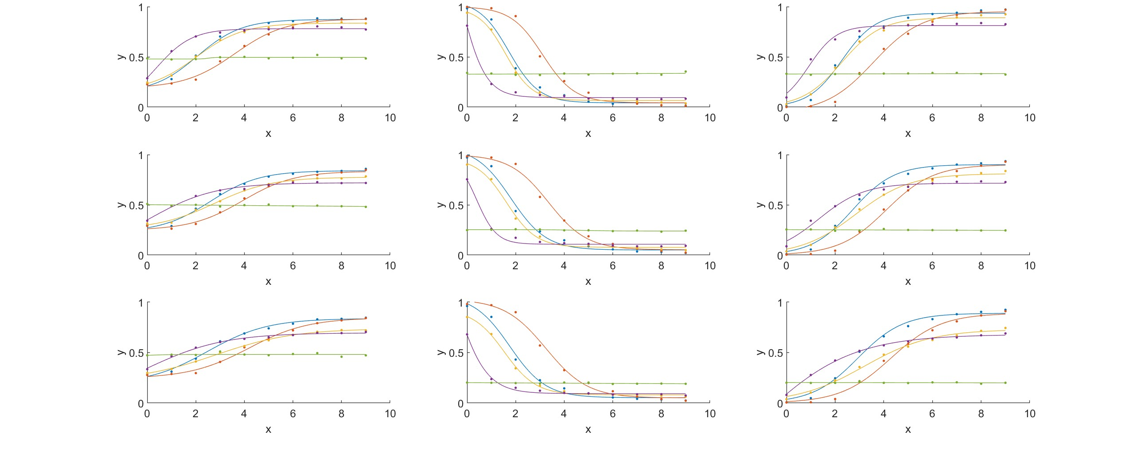
Fitting to curves to logistic- examples
Reward
Old Bandit
New Bandit

Slide 24
Distributions

Slide 25
Maximum Probability of Reward (Post-Switch)

